Slide 1

Customer Shopping Behavior Analysis
Examining purchasing patterns from 3,900 orders to reveal insights into spending habits, customer segmentation, and product preferences for data-driven business decisions.

Slide 2
Dataset Overview
3,900
18
37
Total Records
Key Features
Missing Values
Customer transactions analyzed
Attributes tracked per order
Only in review ratings
Customer Demographics
Transaction Details
Age, gender, location
Product, category, amount
Subscription status
Season, size, color
Previous purchase history
Discount and shipping type

Slide 3

Data Preparation Process
01
Data Import & Assessment
Loaded dataset using pandas and analyzed structure with df.info() and df.describe() functions.
02
Data Cleansing
Filled missing review ratings with category-wise medians and standardized column names to snake_case.
03
Feature Engineering
Created age_group variable and derived purchase_frequency_days from timestamps.
04
Quality Checks
Removed redundant promo_code_used field and uploaded cleaned data to PostgreSQL.

Slide 4
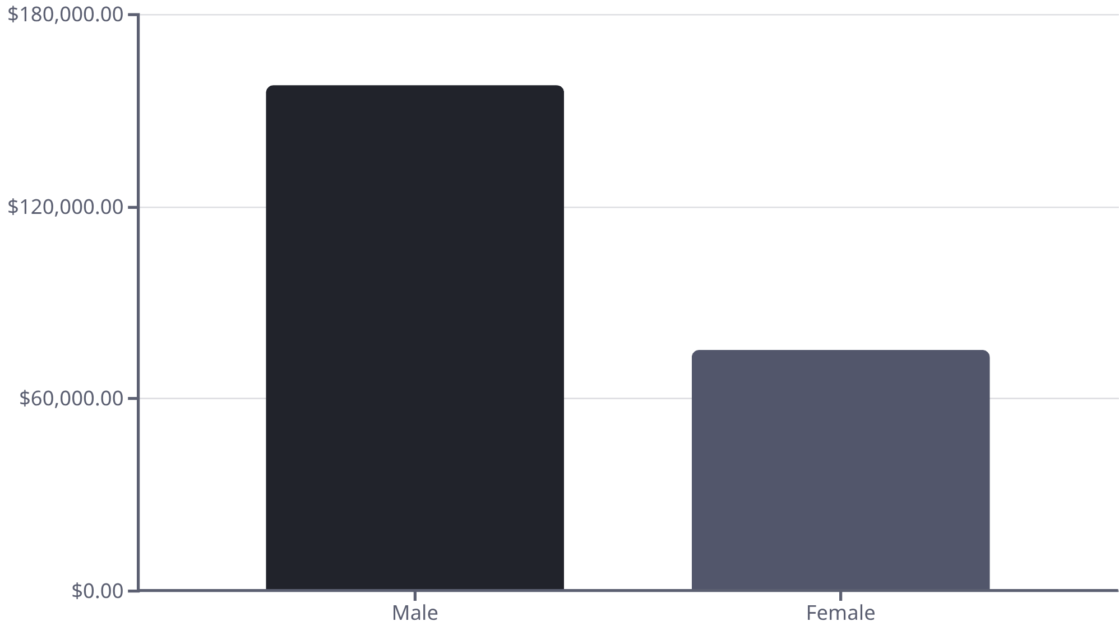
Revenue Insights by Gender
Male customers generate $157.89K in total revenue, more than double the $75.19K from female customers.
This significant gap suggests opportunities for targeted marketing campaigns to increase female customer engagement.

Slide 5






Top-Rated Products
Gloves
Sandals
Boots
Rating: 3.86
Rating: 3.84
Rating: 3.82
Hat
Handbag
Rating: 3.80
Rating: 3.78
Customer satisfaction is highest for accessories and footwear categories. These top-rated products should be featured prominently in marketing campaigns.

Slide 6
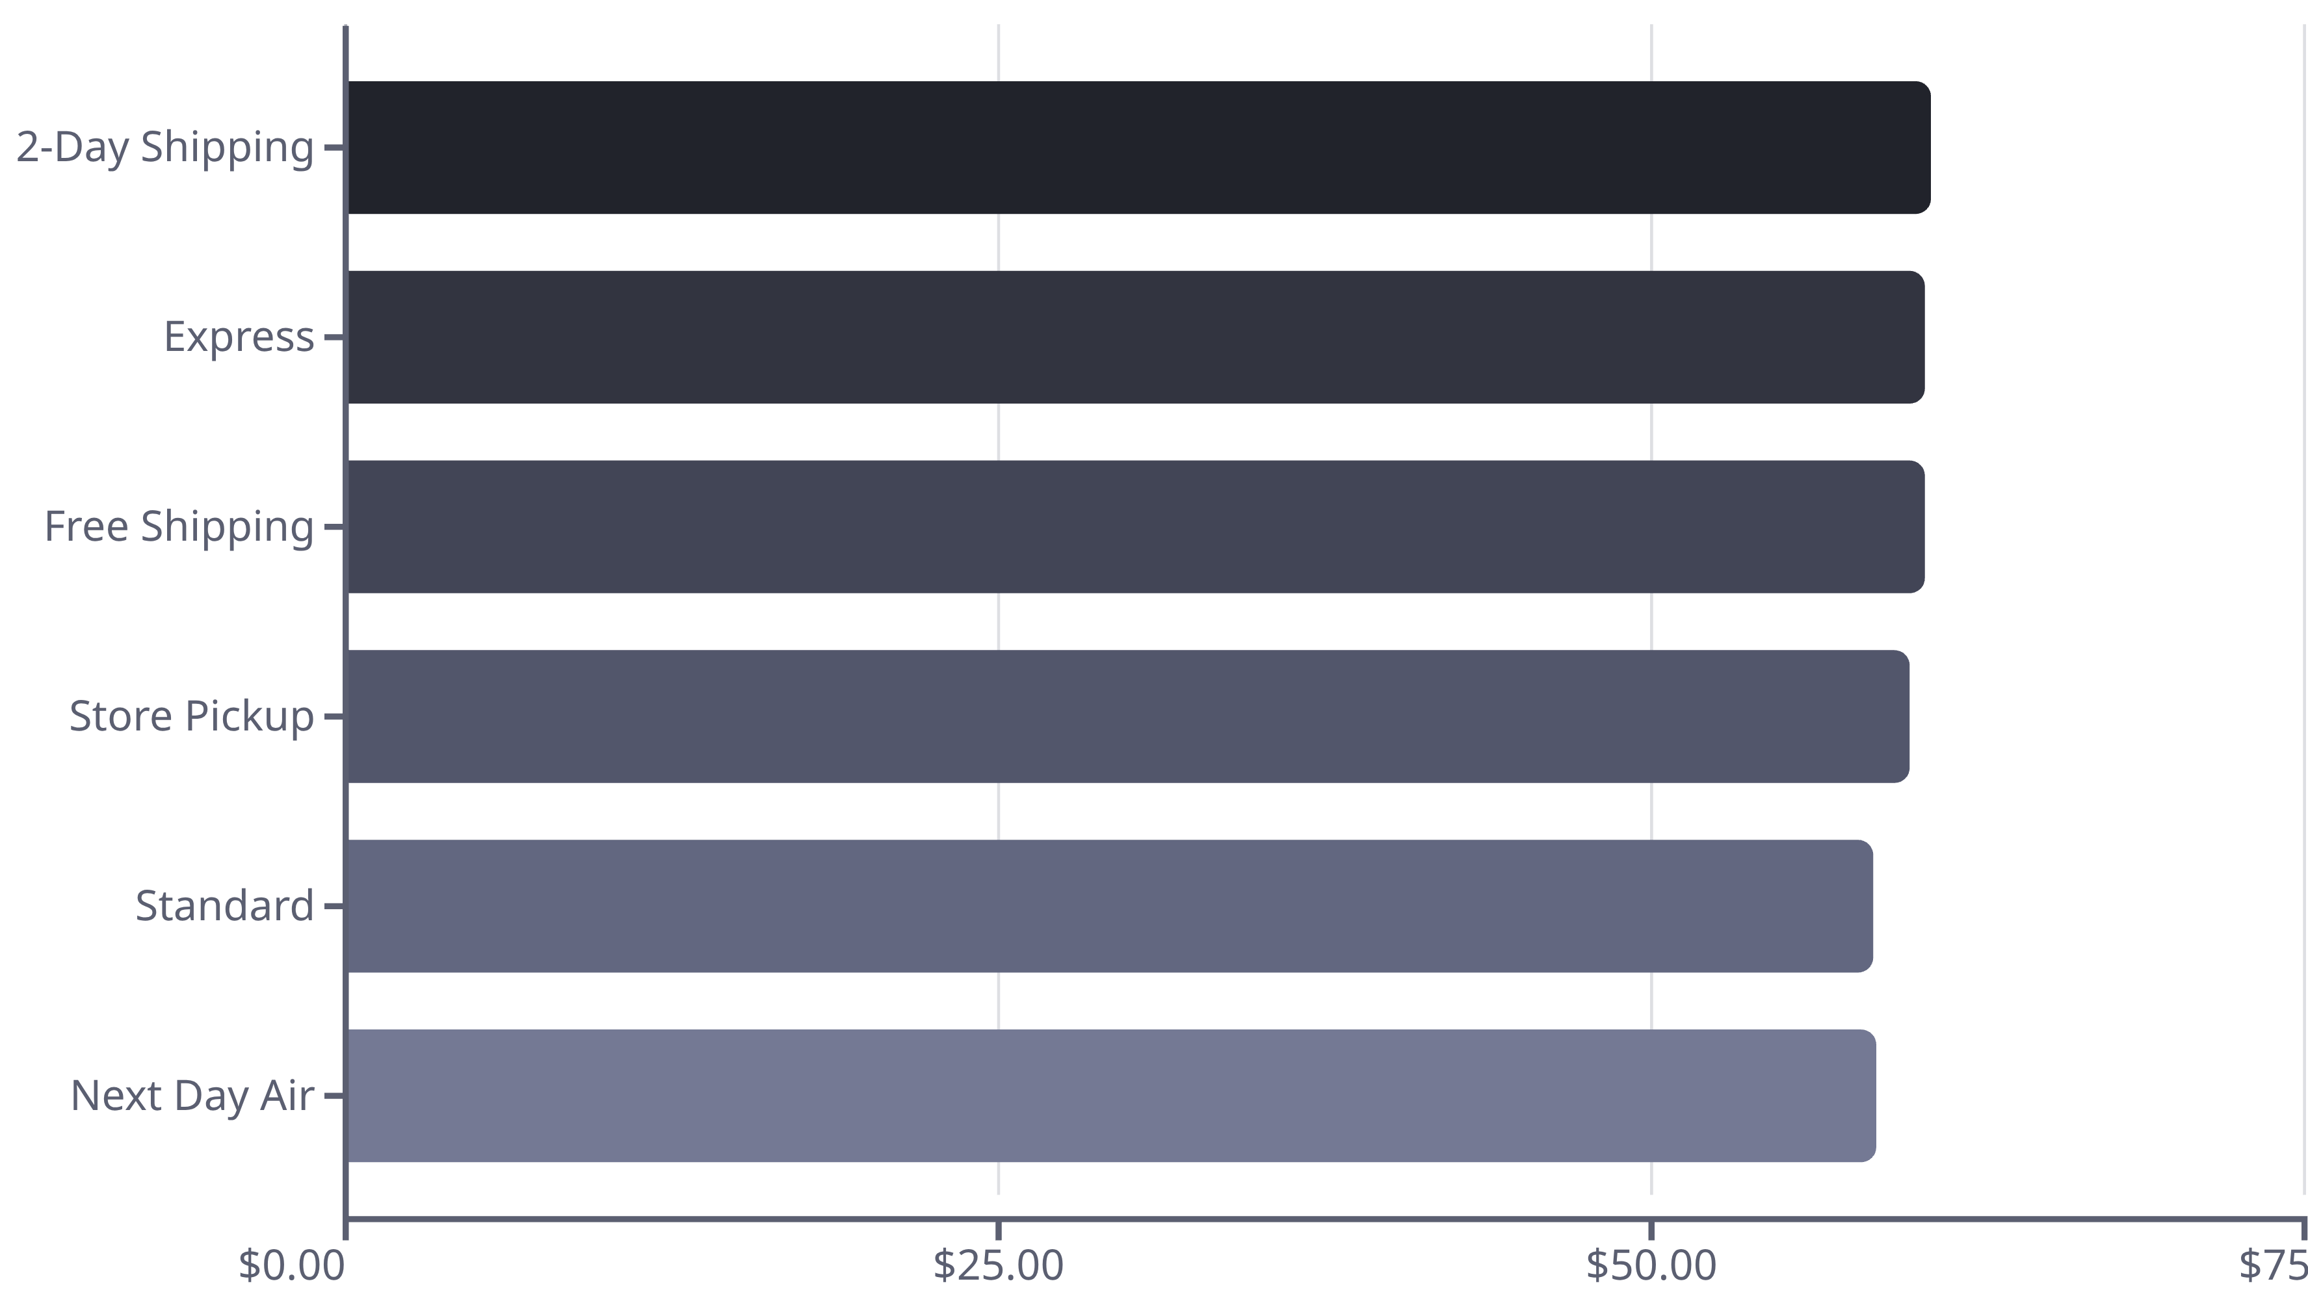
Shipping Type Performance
Premium shipping options correlate with slightly higher purchase amounts. Customers choosing faster delivery tend to spend more per transaction.

Slide 7

Subscriber vs. Non-Subscriber Analysis
Subscribers
Non-Subscribers
1,053 customers
2,847 customers
Average spending: $59.49
Average spending: $59.87
Total revenue: $62,645
Total revenue: $170,436
Only 27% of customers are subscribers, yet spending patterns are nearly identical between groups.
This presents a significant opportunity to convert non-subscribers by highlighting exclusive benefits and value propositions.

Slide 8



Customer Segmentation
New
1
83 customers
Returning
2
701 customers
Loyal
3
3,116 customers
The majority of customers (80%) fall into the Loyal segment, demonstrating strong customer retention. Focus should be on converting Returning customers to Loyal status through targeted incentives.

Slide 9



Revenue by Age Group
Key Insights
Adults drive nearly half of total revenue
Young Adults represent strong secondary market
48%
Senior Citizens show untapped potential
Age-targeted campaigns should prioritize Adult and Young Adult segments while exploring growth opportunities with Senior Citizens.
Adults
$111.53K revenue
32%
Young Adults
$74.66K revenue
20%
Senior Citizens
$46.89K revenue

Slide 10




Strategic Recommendations
Increase Subscription Adoption
Highlight exclusive subscriber benefits to convert the 73% non-subscriber base and drive recurring revenue.
Strengthen Loyalty Programs
Incentivize frequent buyers to transition from Returning to Loyal segment with rewards and personalized offers.
Optimize Discount Strategy
Reassess discount campaigns to balance sales growth with profitability, focusing on high-margin products.
Deploy Targeted Campaigns
Focus marketing on Adult age groups and premium shipping customers who demonstrate higher revenue potential.

